Slide 1



Slide 2
Tonight’s Topics:
Academic Planning
Post-Graduation Options
College Applications
College Tours
Financial Aid and Scholarships
Emotional and Social Support
Senior Events
ZHS | Class of 2026 | Senior Parent Seminar

Slide 3
Louisiana High School Diplomas:
TOPS University is for students pursuing a four-year degree program.
TOPS Tech Jump Start is for students pursuing community college, technical college, or the workforce.
ZHS | Class of 2026 | Senior Parent Seminar
Notes:
In 9th and 10th grade, students took essentially the same course, regardless of their pathway. At the end of 10th grade, students declared a diploma path.

Slide 4
Louisiana High School Diplomas:
In 9th and 10th grade, students took essentially the same course, regardless of their pathway. At the end of 10th grade, students declared a diploma path.
ZHS | Class of 2026 | Senior Parent Seminar
Notes:
In 9th and 10th grade, students took essentially the same course, regardless of their pathway. At the end of 10th grade, students declared a diploma path.

Slide 5
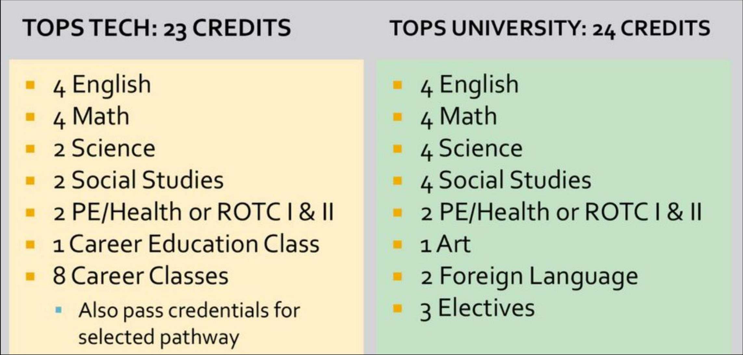
Diploma Requirements:
ZHS | Class of 2026 | Senior Parent Seminar

Slide 6
Grade Level Classification:
9th grade: 0.0 – 5.5 credits
10th grade: 6.0 – 11.5 credits
11th grade: 12.0 – 16.5 credits
12th grade: 17.0+ credits
A student’s grade level is determined by the number of Carnegie units or credits the student has earned. Grade placement is determined only at the beginning of the school year.
ZHS | Class of 2026 | Senior Parent Seminar
Notes:
A student’s grade level is determined by the number of Carnegie units or credits the student has earned. Grade placement is determined only at the beginning of the school year.

Slide 7
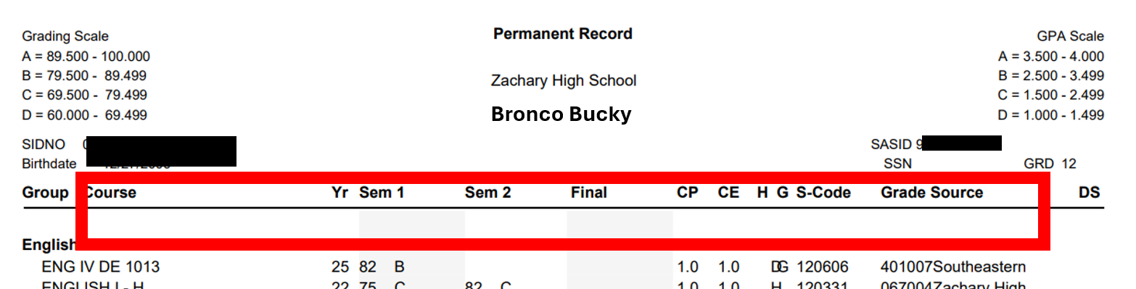
Transcript Overview:
Let’s look at your child’s transcript.
At the very top you will find your child’s name and demographic information (address, birthdate, etc.)
Underneath you will see descriptions of what is listed on the transcript. Reading left to right: the course name, year the course was taken, the grades listed by semester. If you see SS next to a grade, that means your child retook the course in Summer School. If you see CR, that means credit recovery.
ZHS | Class of 2026 | Senior Parent Seminar
Notes:
Let’s look at your child’s transcript.
At the very top you will find your child’s name and demographic information (address, birthdate, etc.)
Underneath you will see descriptions of what is listed on the transcript. Reading left to right: the course name, year the course was taken, the grades listed by semester. If you see SS next to a grade, that means your child retook the course in Summer School. If you see CR, that means credit recovery. There are circumstances where a grade is listed under “Final” instead of by semester. If your child took a new credit course over the summer, the grade is listed under final. CP at the top of the transcript means courses pursued. CE means Courses Earned. The other codes designate honors, AP or DE courses. Over the next few days, please review your child’s transcript with your child to make sure it is accurate. If you notice an error, let me know immediately.

Slide 8
Transcript Overview:
There are circumstances where a grade is listed under “Final” instead of by semester. If your child took a new credit course over the summer, the grade is listed under final. CP at the top of the transcript means courses pursued. CE means Courses Earned. The other codes designate honors, AP or DE courses. Over the next few days, please review your child’s transcript with your child to make sure it is accurate. If you notice an error, let me know immediately.
ZHS | Class of 2026 | Senior Parent Seminar
Notes:
Let’s look at your child’s transcript.
At the very top you will find your child’s name and demographic information (address, birthdate, etc.)
Underneath you will see descriptions of what is listed on the transcript. Reading left to right: the course name, year the course was taken, the grades listed by semester. If you see SS next to a grade, that means your child retook the course in Summer School. If you see CR, that means credit recovery. There are circumstances where a grade is listed under “Final” instead of by semester. If your child took a new credit course over the summer, the grade is listed under final. CP at the top of the transcript means courses pursued. CE means Courses Earned. The other codes designate honors, AP or DE courses. Over the next few days, please review your child’s transcript with your child to make sure it is accurate. If you notice an error, let me know immediately.

Slide 9
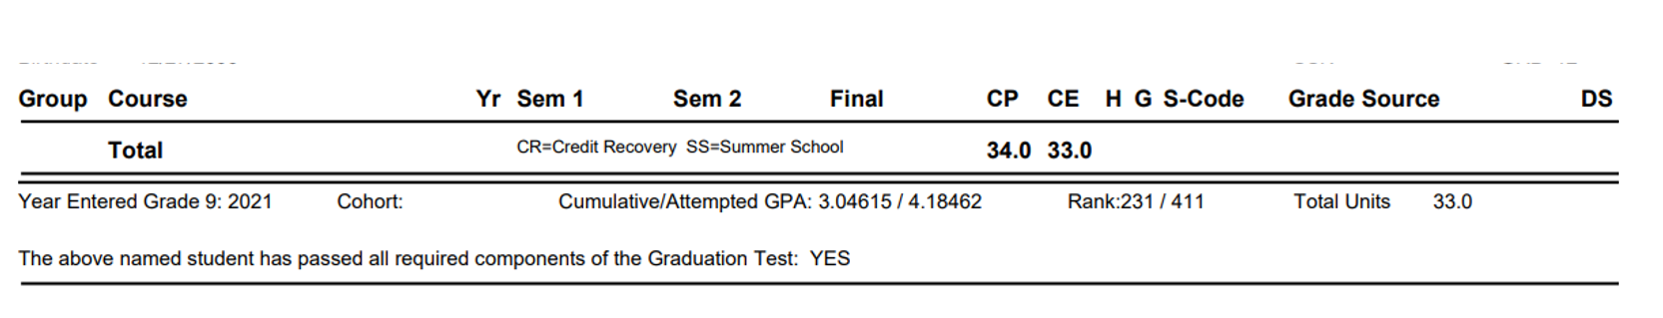
At the bottom of the transcript you will see the total number of credits earned and pursued. Remember, TOPS University needs 24 credits by May. JumpStart needs 23 credits. You will see your child’s GPA and class rank. The last statement reads, “The above named student has passed all required components of the graduation test” followed by yes or no. Refer to the transcript checklist on page 2 of the packet in the blue folder. Make sure your child has taken the correct courses for graduation.
ZHS | Class of 2026 | Senior Parent Seminar
Notes:
At the bottom of the transcript you will see the total number of credits earned and pursued. Remember, TOPS University needs 24 credits by May. JumpStart needs 23 credits. You will see your child’s GPA and class rank. The last statement reads, “The above named student has passed all required components of the graduation test” followed by yes or no. Refer to the transcript checklist on page 2 of the packet in the blue folder. Make sure your child has taken the correct courses for graduation.

Slide 10
LEAP Graduation Requirements:
High schoolers must pass these exams
English I or English II
Algebra I or Geometry
Biology or US History
Students can fail the LEAP exam but pass the course. Students can pass the LEAP exam but fail the course.
LEAP exams count as 15% of the final grade in the course.
ZHS | Class of 2026 | Senior Parent Seminar
Notes:
Students can fail the LEAP exam but pass the course.
Students can pass the LEAP exam but fail the course.
LEAP exams count as 15% of the final grade in the course.

Slide 11
Individual Growth Plan (IGP):
The IGP is updated yearly.
The IGP is aimed to help students explore education and career options.
The IGP must be completed and submitted to graduate.
ZHS | Class of 2026 | Senior Parent Seminar

Slide 12
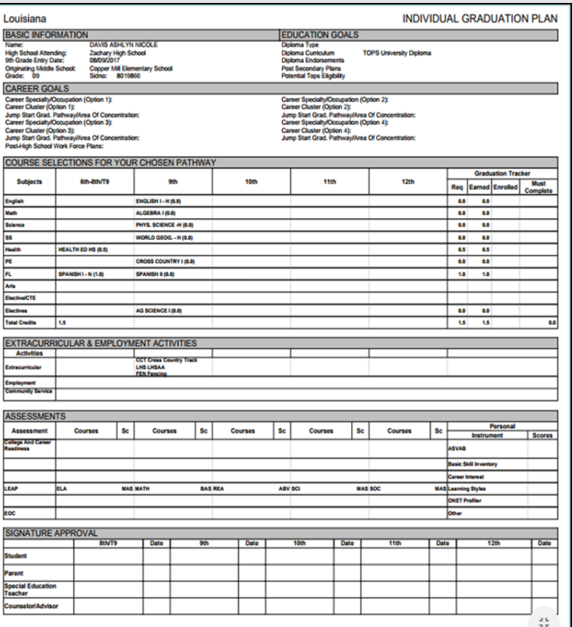
Sample IGP
ZHS | Class of 2026 | Senior Parent Seminar

Slide 13
District and State Testing:
ACT
ACT WorkKeys
AP ($100/test due 11/5/25)
LEAP
SAT
ZHS | Class of 2026 | Senior Parent Seminar

Slide 14
LOSFA Consent Form:
Students are required to have a consent form on file to allow the school to release information pertaining to TOPS, college admissions, financial aid programs, grants, and scholarship opportunities.
ZHS | Class of 2026 | Senior Parent Seminar

Slide 15
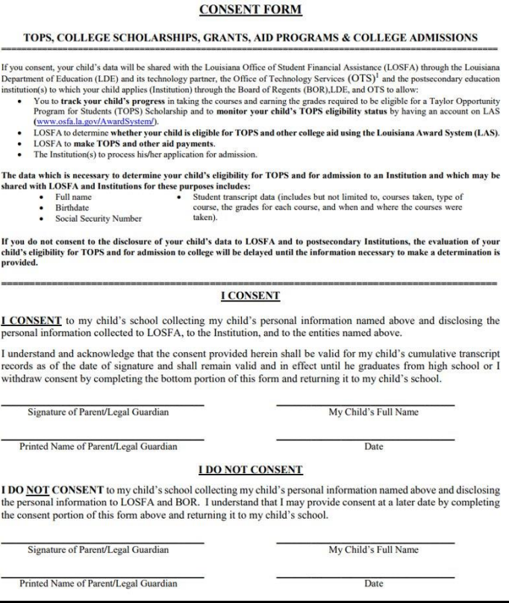
Consent Form
ZHS | Class of 2026 | Senior Parent Seminar

Slide 16
Senior Service Hours:
Red, white, and blue cord
At least 20 hours required
10 hours of service to the elderly
10 hours of service to the community or the school
ZHS | Class of 2026 | Senior Parent Seminar

Slide 17

Post-Secondary
Options
We realize that all students do not plan to attend college.
There are other options:
Our JROTC program is top notch.
We offer internships, technical courses,
and workplace classes.
ZHS | Class of 2026 | Senior Parent Seminar
Notes:
We realize that all students do not plan to attend college. There are other options. Our JROTC program is top notch. We offer internships, technical courses, and work place classes.

Slide 18

College
Application
Process
Ms. Ducote, one of our English IV teachers and Senior Class Sponsors discussed the college application process and financial aid.
ZHS | Class of 2026 | Senior Parent Seminar
Notes:
Ms. Ducote, one of our English IV teachers and Senior Class Sponsors discussed the college application process and financial aid.

Slide 19
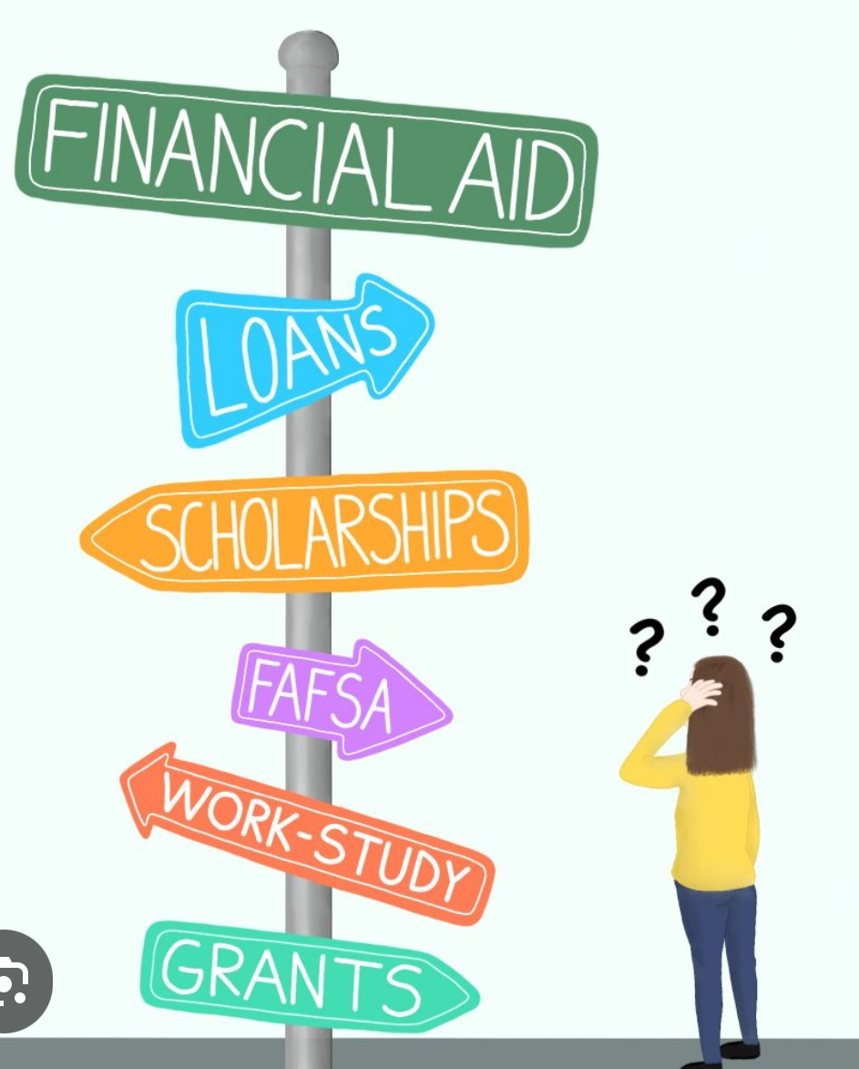
Financial Aid
and
Scholarships
FASFA opens on October 1st.
ZHS | Class of 2026 | Senior Parent Seminar
Notes:
FASFA opens on October 1st.

Slide 20
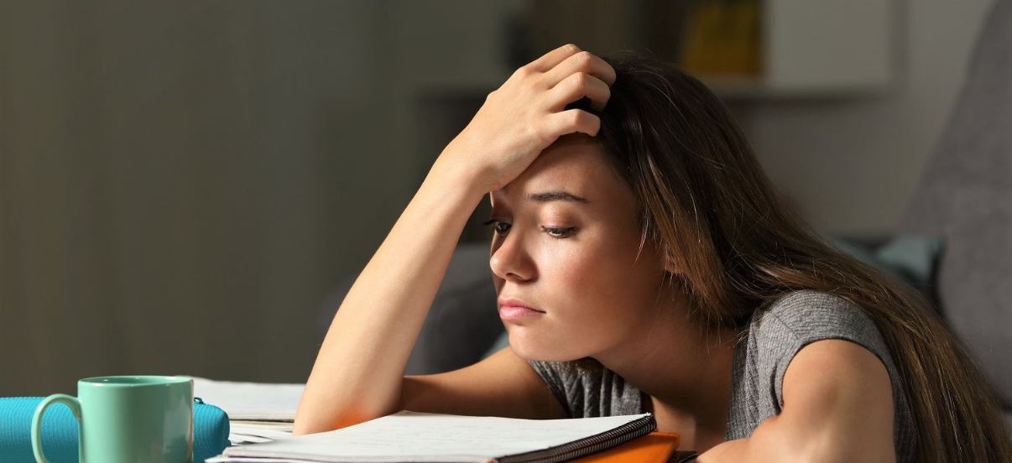
Emotional
and
Social Support
Senior year can be stressful. Ways to avoid “senioritis” are as follows:
Use the reward system. Students should promise themselves small rewards.
Finish a math assignment? Watch an episode of your favorite show.
Limit distractions. Use tools like Focus apps (Freedom, Forest, or Cold Turkey).
These help manage distractions by blocking websites and other apps.
Keep a visual countdown. Mark off days until a big project or a test.
Seeing the end can keep students from drifting.
ZHS | Class of 2026 | Senior Parent Seminar
Notes:
Senior year can be stressful. Ways to avoid “senioritis” are as follows:
Use the reward system. Students should promise themselves small rewards. Finish a math assignment? Watch an episode of your favorite show.
Limit distractions. Use tools like Focus apps (Freedom, Forest, or Cold Turkey). These help manage distractions by blocking websites and other apps.
Keep a visual countdown. Mark off days until a big project or a test. Seeing the end can keep students from drifting.

Slide 21
Save the Dates:
August 8 – Parking Lot Party – 2:30 PM
August 28 – Open House – 6 PM
September 9 - National College Fair - Baton Rouge​​ at the Raising Cane's River Center​
https://www.nacacattend.org/25batonrouge​
September 17 – College & Career Fair – 6 PM
ZHS | Class of 2026 | Senior Parent Seminar

Slide 22
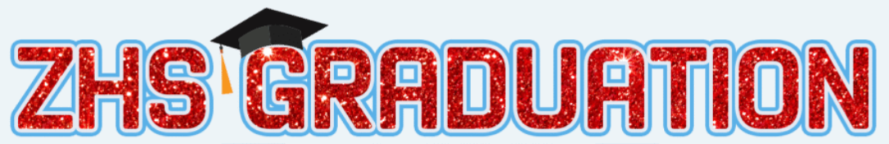
May 20, 2026
ZHS | Class of 2026 | Senior Parent Seminar

Slide 23

Mico Cooper, Senior Counselor
Mico.Cooper@zacharyschools.org
Erica Henry, Assistant Principal
Erica.Henry@zacharyschools.org
Lindsey Spence, Principal
Lindsey.Spence@zacharyschools.org
ZHS | Class of 2026 | Senior Parent Seminar

Slide 24



ZHS | Class of 2026 | Senior Parent Seminar

